Slide 1
Template Design Using
HTML/CSS
Maimuna Akhtar
Student of The Virtual BD

Slide 2
What is The WebSite Template?
A web design template or a website design template is a template which is most cases used to present some information in the Internet.
It is a predesigned resource that shows the structure for the comprehensive layout and display feature of any website. It’s built through classic Web language such as HTML and CSS.

Slide 3
What is The HTML and CSS?
HTML(Hypertext Markup Language) and CSS(Casecading Style Sheets) are two of the core technologies for building Web pages.HTML provides the structure of the page, CSS the layout, for a variety of devices.
With CSS, you can control the colours, font, the size of text, font-awesome icon, the spacing between elements, how elements are positioned and laid out, what background images or background colours are to be used, different displays for different devices and screen sizes, and much more.

Slide 4
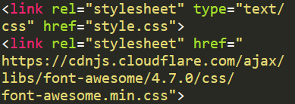
What is The HTML and CSS?
Here, I add CSS to HTML document by using <link> element –

Slide 5

What is Responsive Web Design?
Responsive Web Design about using HTML and CSS to automatically resize, hide, shrink or enlarge a website to make it look good on all devices. (Desktops, Tablets and Phones)
To create a responsive website ,add the following <meta> tag in this code –

Slide 6

HTML Layout
  Websites often display content
  in multiple columns.(like a magazine
  or a newspaper)
  HTML has several semantic elements
  that define the different parts of a web
  page. Such as -<header>,<nav>,
  <section>,<article>,<aside>,<footer>,
  <details>,<summary>
  There are four different techniques to
  create multicolumn layouts –
- CSS framework
- CSS float property
- CSS flexbox
- CSS grid
Blog name
Navigation bar
Section 01
Section 03
Section 02
Section 04
Footer

Slide 7
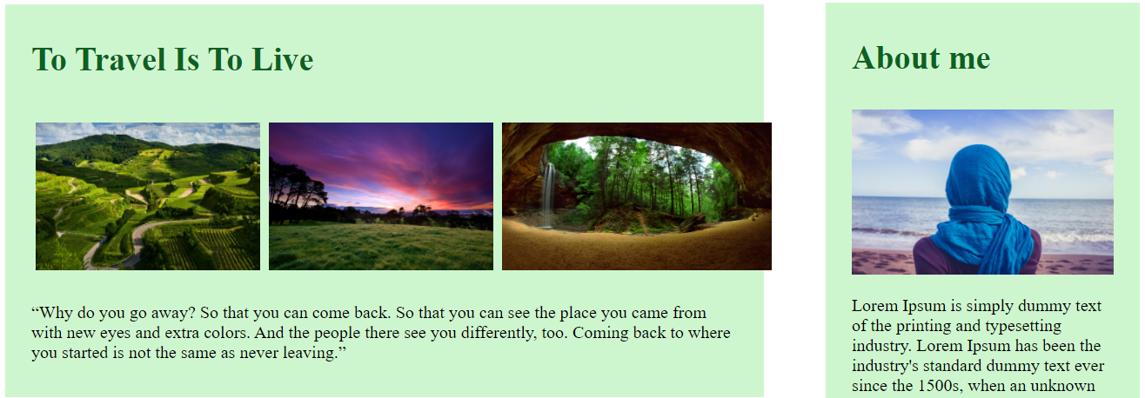
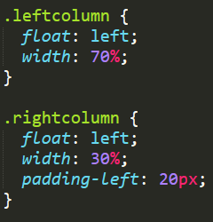
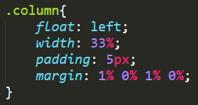
HTML Layout
CSS Float Layout is used to make
this Template. It is common to do
entire web layouts using CSS float
property.
Here, using some CSS float
property, create some columns in
this template.

Slide 8
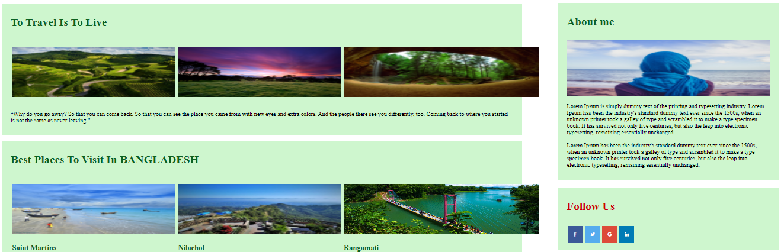
Section - <div>
<div> tag is defined a section or
division in a document that is styled
with CSS.
This tag is easily styled by using the
class or id attribute.
Any sort of content can be put inside
the <div> tag!
Here,create some section using <div>

Slide 9
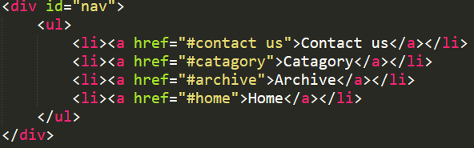

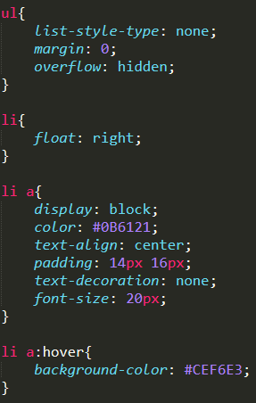
Navigation Bars
Having easy-to-use navigation
is important for any web site.
With CSS you can transform
boring HTML menus into good-
looking navigation bars.

Slide 10

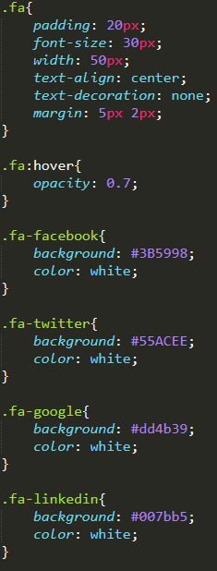
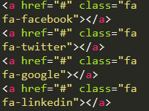
Icons
To use Font Awesome 4 Icons add
this link inside the <head> section
of HTML page.
To design this Icons, use some
CSS property and add in the
HTML page.

Slide 11

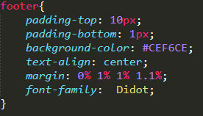
Footer
The <footer> tag defines a footer
for a document or section.
Here use CSS to style footer
section.

